Slide 1
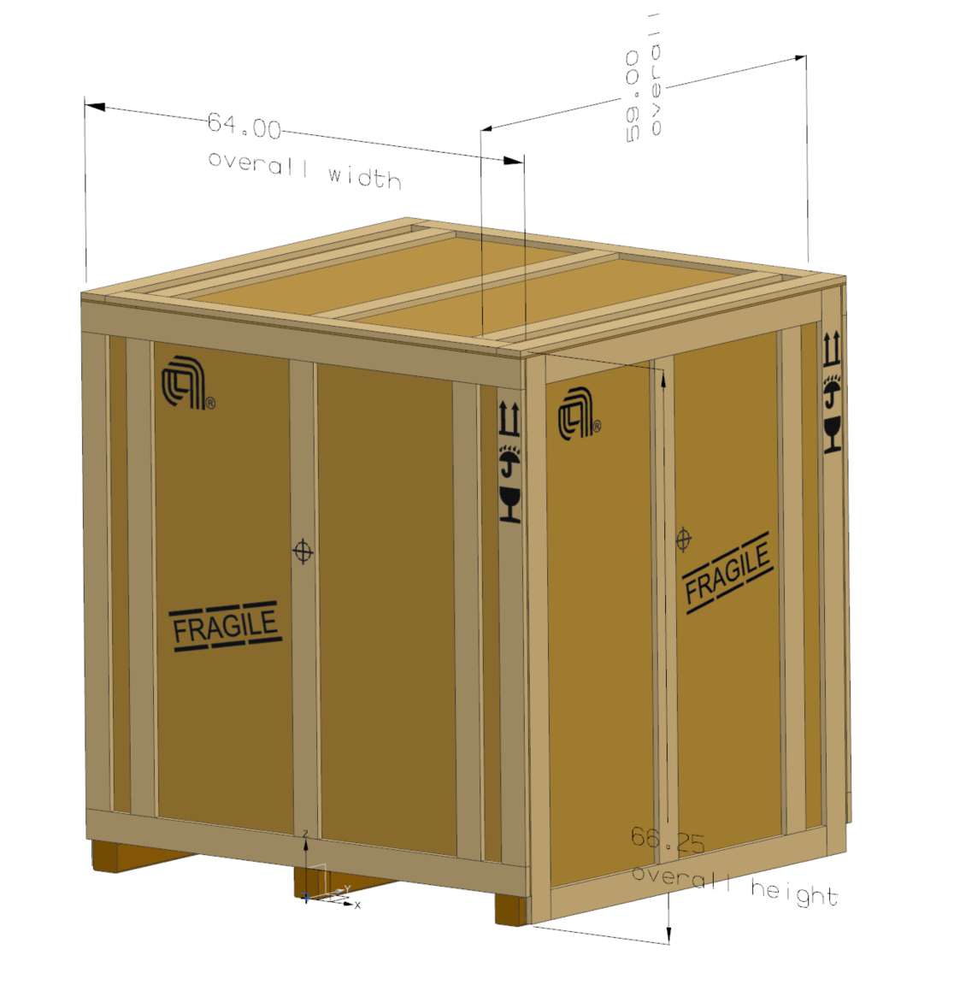
Coordinate system at the front of the assembly with Z pointing up and Y to the rear and X to the right. The X-Y plane is on the floor.

